Slide 1


CISC3003-WEB PROGRAMMING
THE PET HOME WEBSITE
TEAM 01
DC025027 AO CHI LAM
DC027857 WANG XINYU
DC027353 CAO YUTING
DC026157 WONG KAI YUAN
DC328783 JOÃO PAULO MONTEIRO BARROS CEVA RODRIGUES
DC126114LEI CHAK FONG
DC125943WONG CHI CHON

Slide 2


CONTENT
01 02
03
04
05
06
07
INTRODUCTION
OUR GOAL
THE MAIN SERVICES
OUR TARGET USER
USER WORKFLOW TECHNICAL TECHNICAL VISION
WEB PAGE INTRODUCTION

Slide 3






INTRODUCTION
Our mission is to provide pet owners with a convenient and reliable online shopping experience, offering a wide range of products that cater to the needs and preferences of pets and their owners.
Our website is going to be designed to be user-friendly and easy to navigate, with clear categories and search functions that allow customers to find the products they need quickly and easily.
We aim to provide
affordable and practical solutions to customers who are looking for pet products and information.
PET HOME WEBSITE.
DESIGN CONCEPT
OUR VALUE

Slide 4


OUR GOAL
Create lasting bonds between pet owners and community.
Be a top online hub for practical pet care and a nurturing community.
Offers support, advice, and quality products.

Slide 5
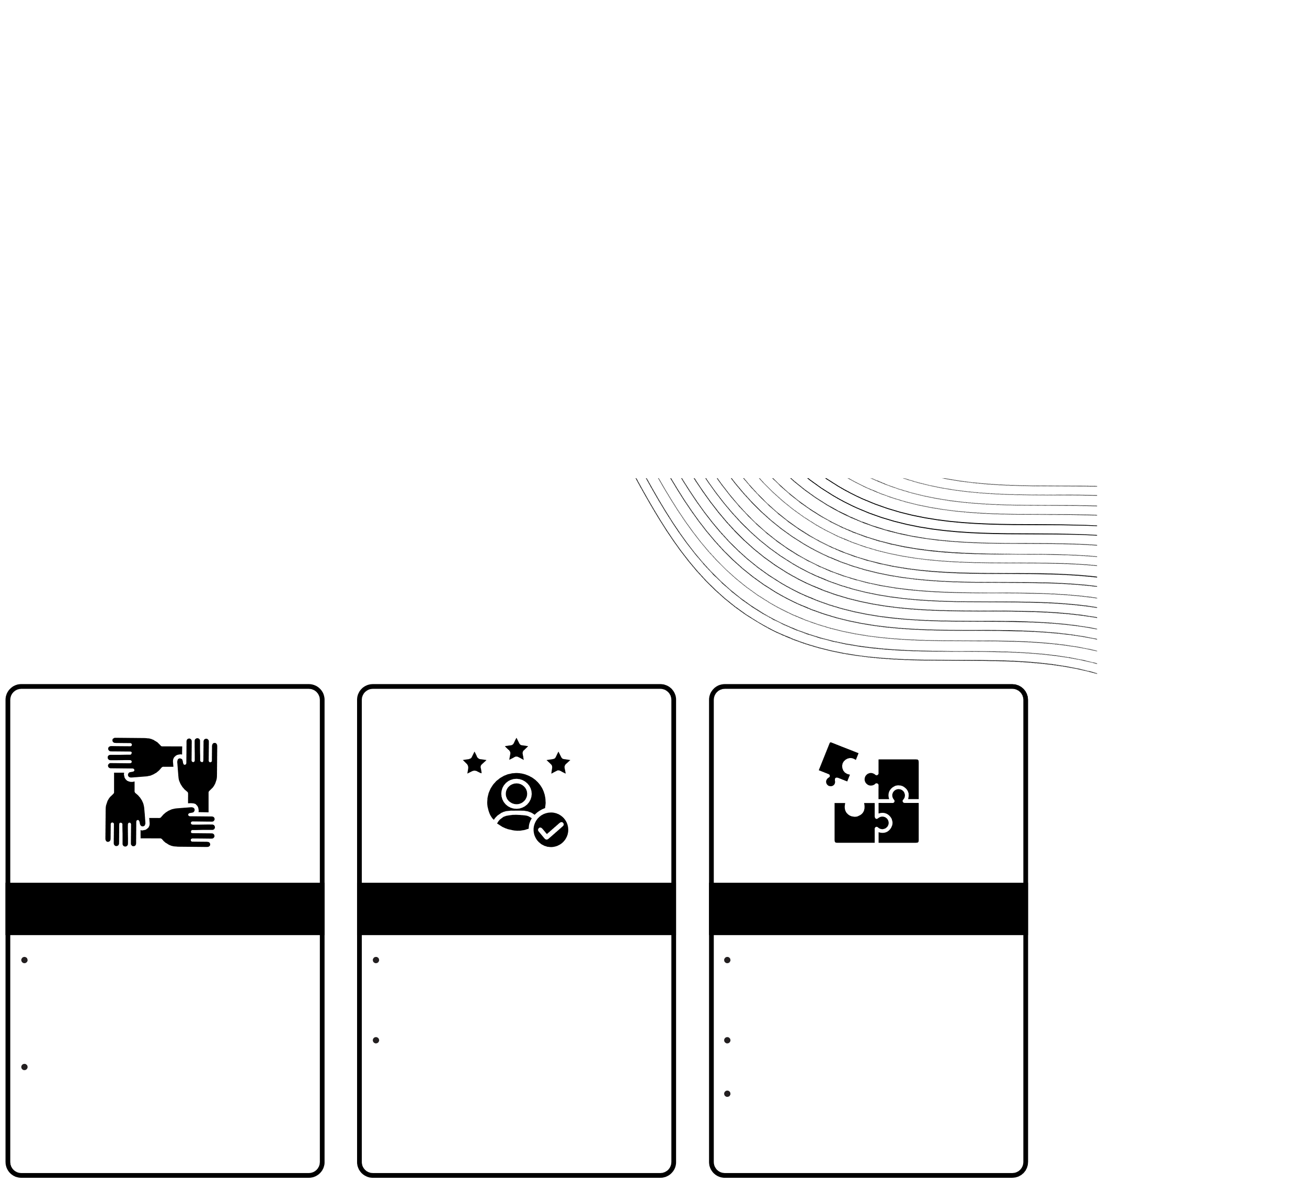

THE MAIN SERVICES
Login/Register
Community Forums
Blog
Store Page
Simplifies the process of creating a secure account.
Register with mail activation.
Login with activated account.
Members engage in lively discussions, dispense and receive advice.
Strengthen their bonds over shared pet-rearing experiences.
Educational treasury populated with articles from pet care experts.
Blog serves as a trove of knowledge for pet wellness and upkeep.
Provide pet products including foods, supplments, toys for dogs, cats.

Slide 6








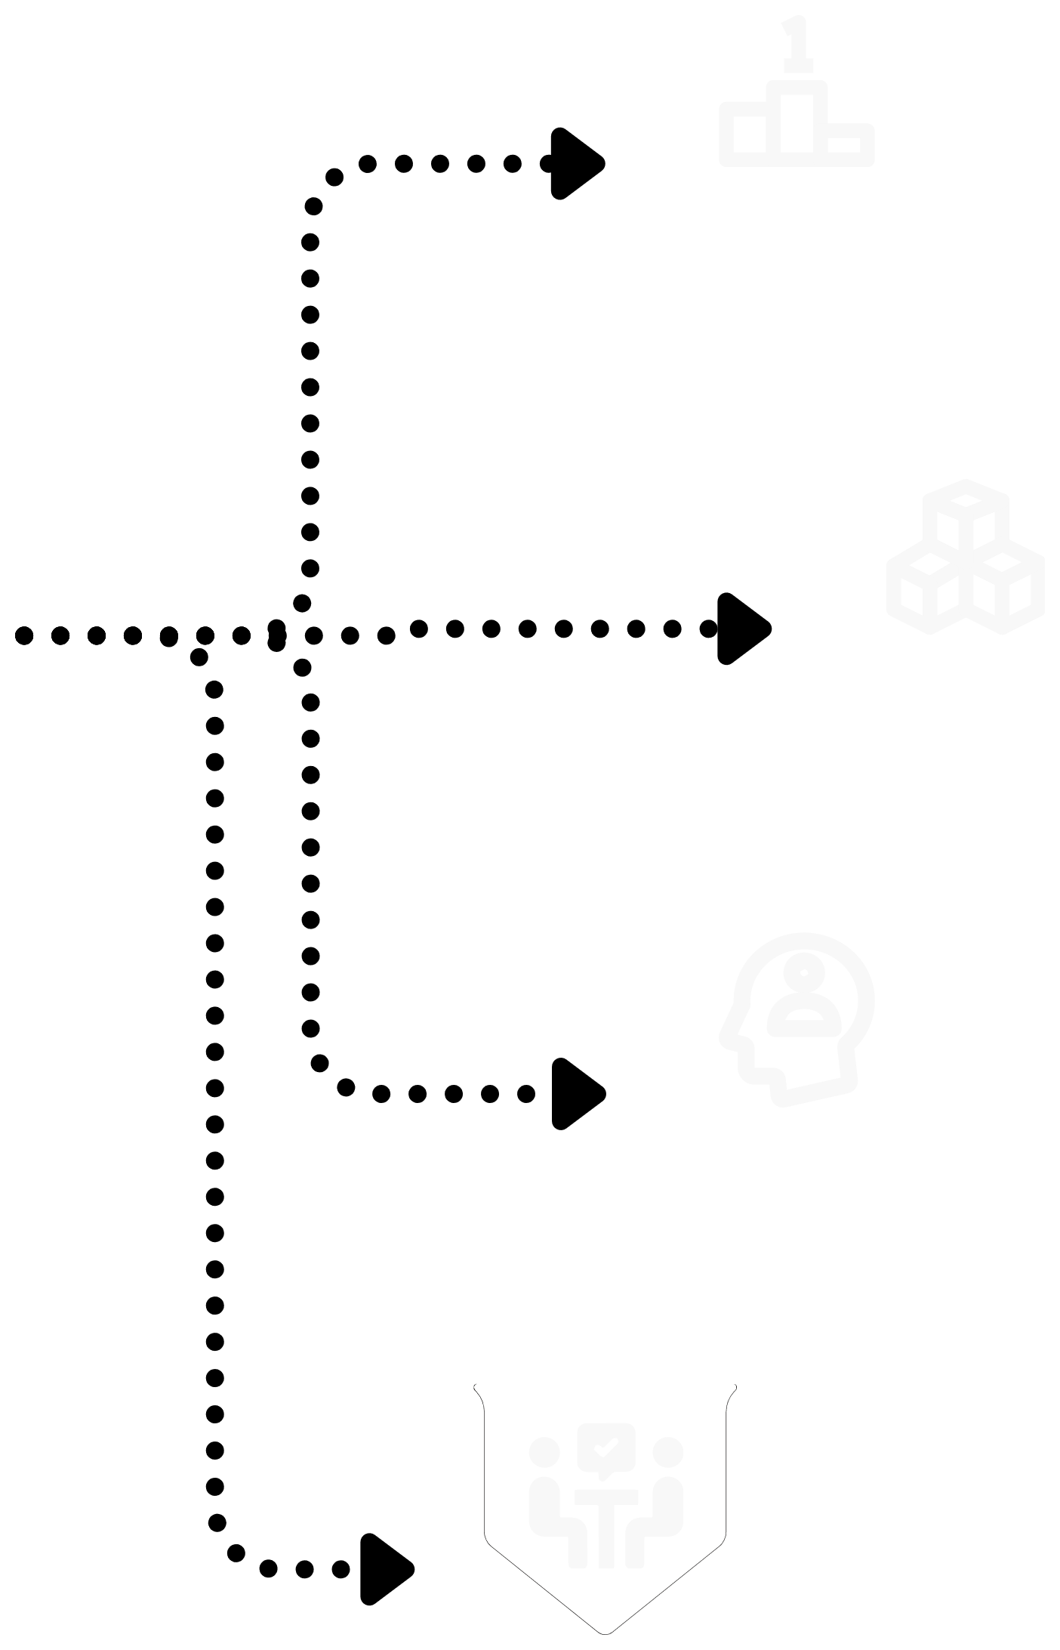





Novice Pet Owners
For those just starting out, PetHome provides a nurturing environment full of guidance, support, and essential products to ensure a smooth beginning to their pet-care journey.
Experienced Pet Guardians
Veteran pet owners will find advanced resources, community forums for in-depth discussions, and a comprehensive range of products to support the continued well-being of their companions.
OUR TARGET USER
Urban Pet Lovers
Our platform is ideal for those residing in bustling cities, seeking advice on raising pets in smaller living spaces and connecting with other urban pet owners for shared experiences and tips.
Community Seekers
Individuals looking for a sense of belonging and interaction with like-minded pet lovers. PetHome's forums and blogs foster a sense of community and mutual support.
Conscientious Shoppers
Users who value convenience without compromising on the quality and variety of pet care supplies. PetHome’s online store offers a curated selection of products to fit their lifestyle and their pets' needs.

Slide 7


USER WORKFLOW
The blog stands as a pillar of PetHome, offering comprehensive articles that dive into pet health, behavioral insights, and nutritional advice.
With a variety of pet products on offer, the store page is a one- stop-shop for all pet care necessities, providing an enriching shopping experience.
The forum invites users to dive into rich dialogues, share anecdotes, and seek counsel, all in the spirit of enhancing life with pets.
KNOWLEDGE EXPANSION
SHOPPING
ENGAGEMENT

Slide 8


TECHNICAL VISION
01
02
03
04
HTML AND CSS
PHP AND JS
MYSQL
PHPMAILER
Employing HTML and CSS for an aesthetically pleasing and user-friendly interface
For interactive or dynamic content, we realize it by PHP and JavaScript.
MySQL will be used as our back-end database to record and store the information of our customers and items.
PHPMailer will be used to complete automated email sending, including sending account activation links and reset links.

Slide 9
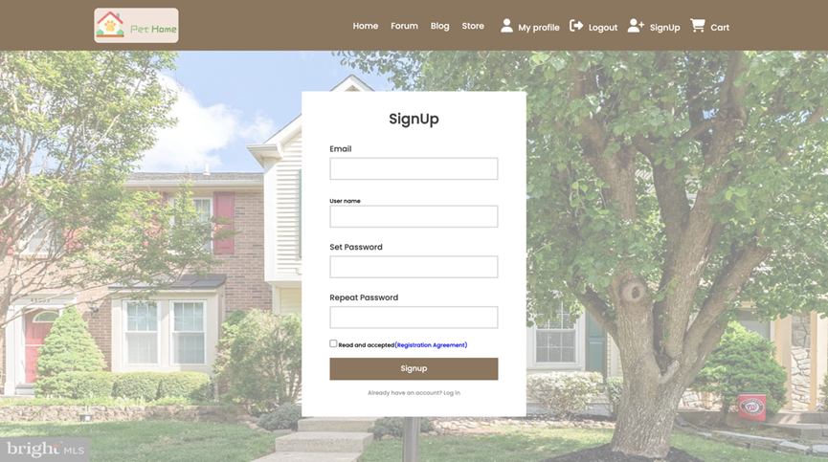

SIGN UP
Input boxes for sign up information collection
Button to submit information (can only success submit if input all required information, and repeat password same with set password, and click agree checkbox)
Submitted information stored in table ‘user’
After success submission, a verify email is sent to the input email box, account is activated after verify.

Slide 10
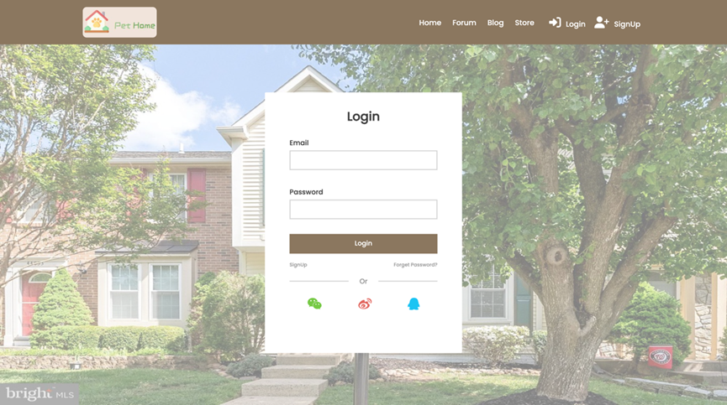
LOGIN
Input boxed for log in information.
Button to submit information (can only success if all input boxes have content, email is registered, password is correct - same with recorded password in database)
If input email is not registered, go to sign up page.
Links to sign up page and reset page.

Slide 11
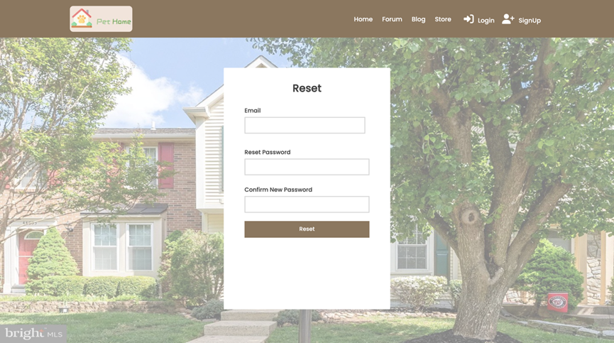
RESET PAGE
Input boxed for reset password information.
Button to submit information (can only success if all input boxes have content and reset password same with confirm password)
After successful submission, a verify email is sent to the input email box, new password is activated after verify.

Slide 12
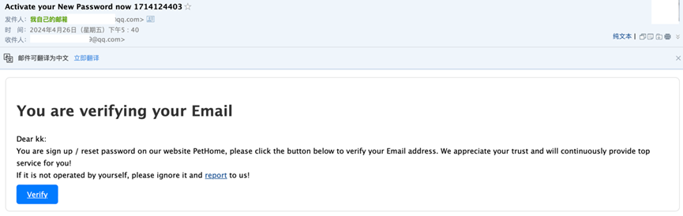
VERIFY EMAIL
Automatically send to mailbox.
Include the register name of user.
Button to verify sign up / reset password, link back to log in page.
Not actually able to report error.

Slide 13
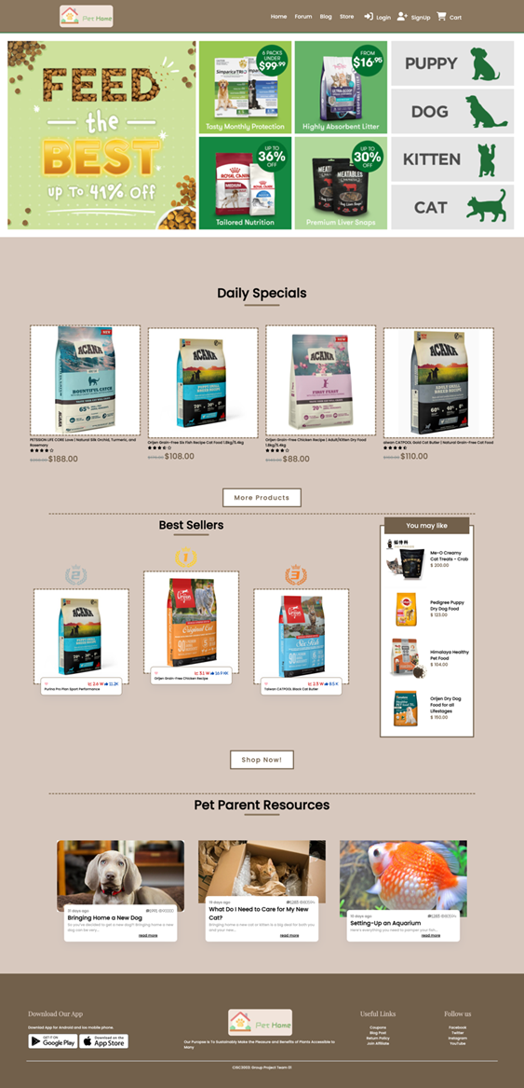
HOME
The homepage of the website
Display discount information, daily special, best seller and blog recommendation.
Provides an overview and navigation of the website

Slide 14
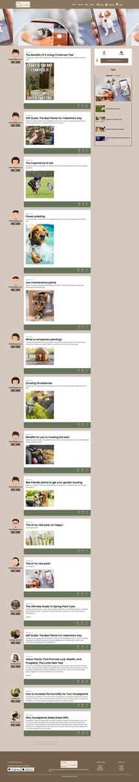
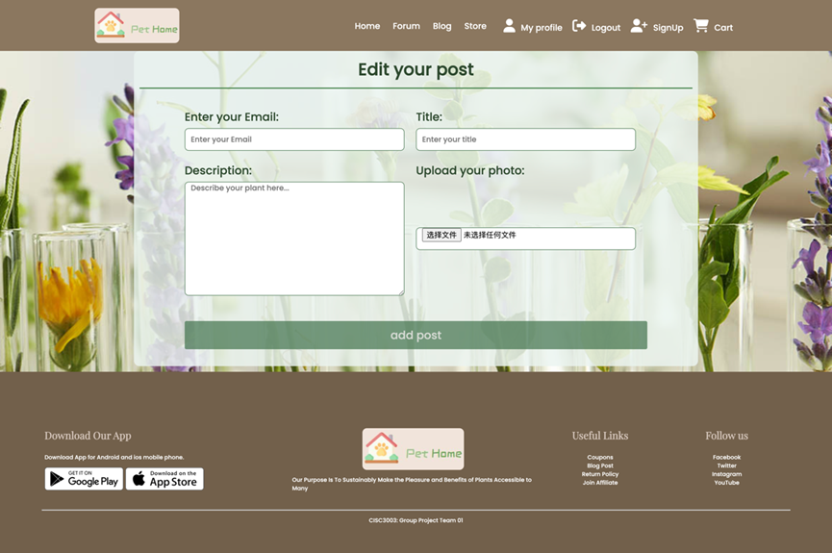

FORUM & POST

Slide 15
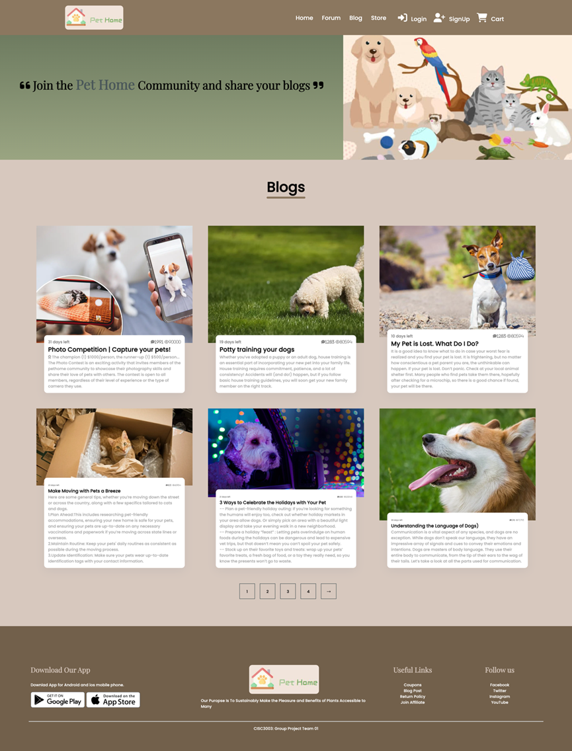
BLOG
Dedicated to users sharing with each other.
Users can read and browse a variety of blog posts on specific topics

Slide 16
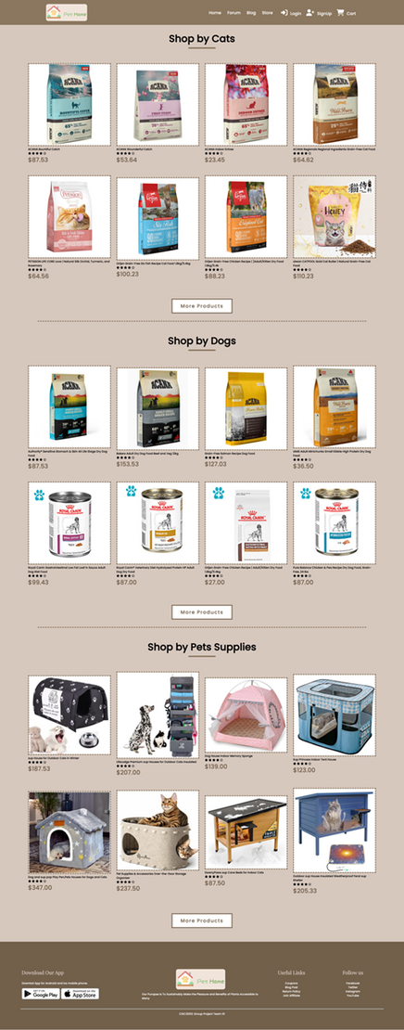
STORE
Items demonstration for cats, dogs and pet supplies
Button to enter these shops
Can click the image to enter product page

Slide 17
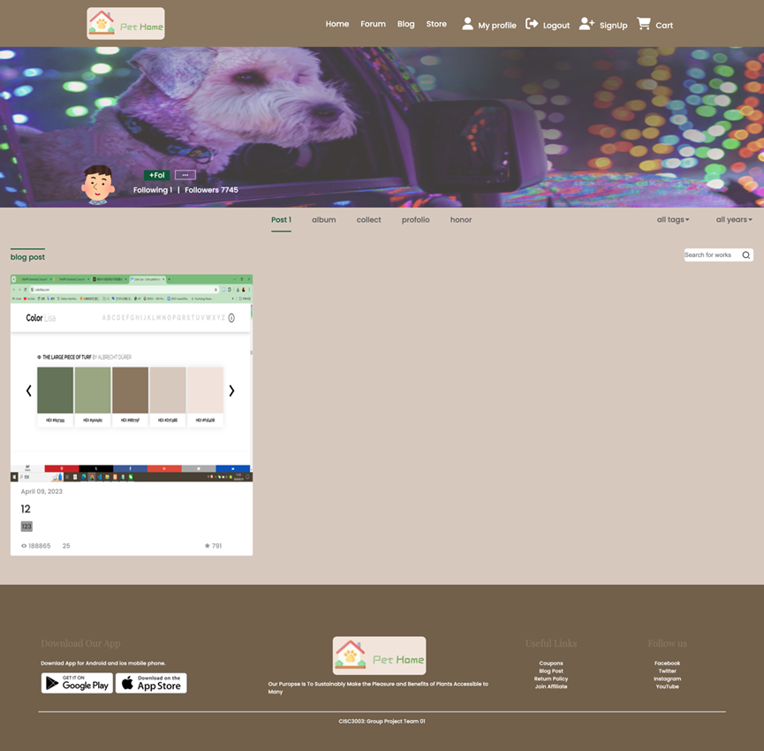
PROFILE
The sign up information and post blog of the user
Only visible in navbar if the user has logged in

Slide 18
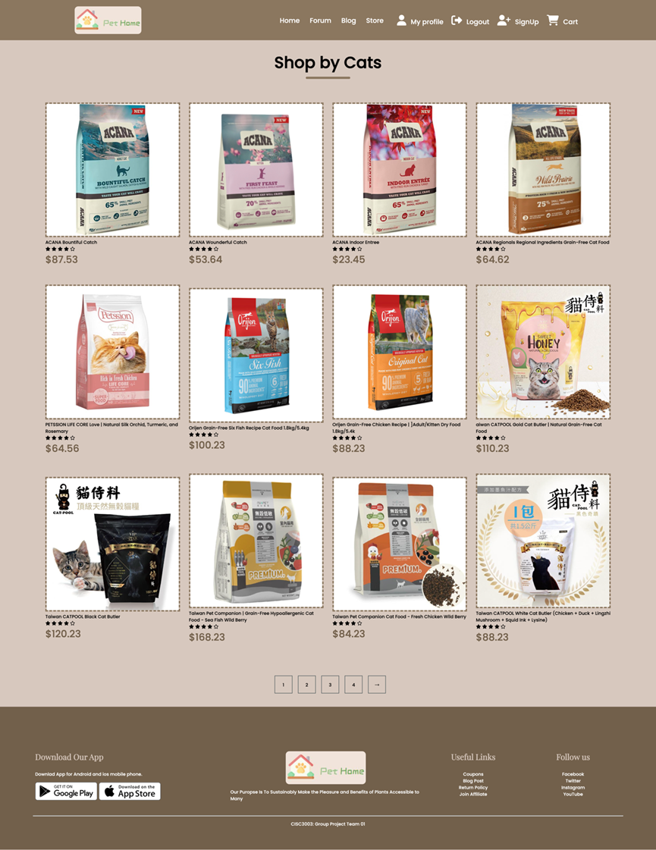
SHOP
Present the items’ image, title, score and price
Can click the image to enter product page

Slide 19
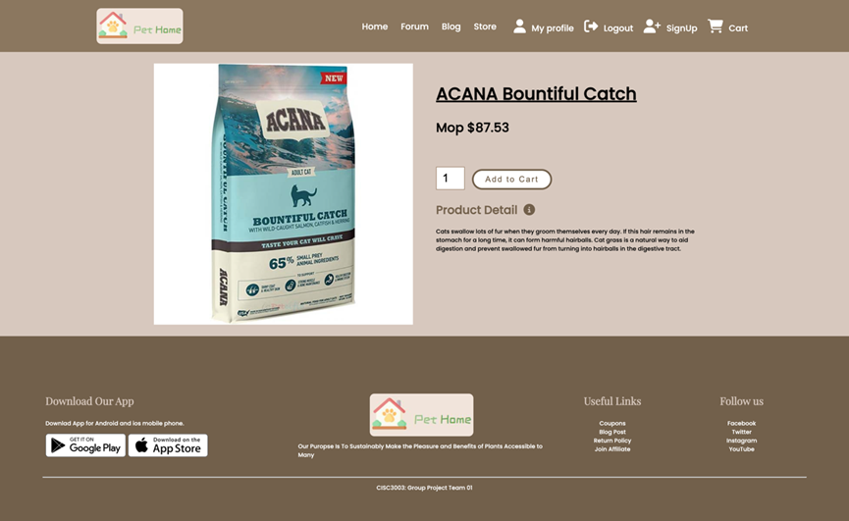
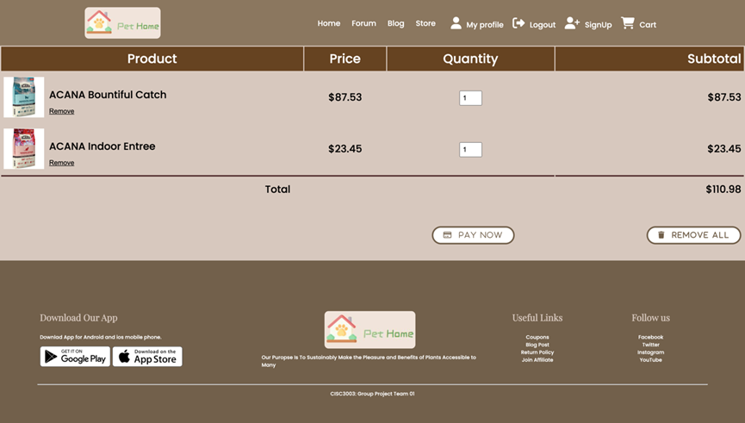
PRODUCT
CART

Slide 20

THANKS FOR WATCHING

